Slide 1

Micro-Credit Defaulter Project
Submitted by :-
Shubham Dewangan

Slide 2
Data Preparation
With the help of Pandas Library We will upload our data to Jupyter Notebook.
Once our data is uploaded with the help of predefined method (i.e. read_csv) we can read data for further processing.
We have two type of variables in the data:-
  Dependent Variable
  Independent Variable

Slide 3
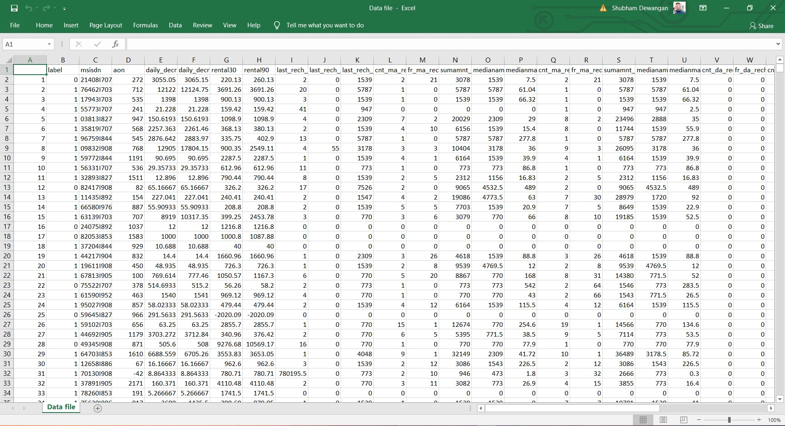
Data file in CSV format

Slide 4
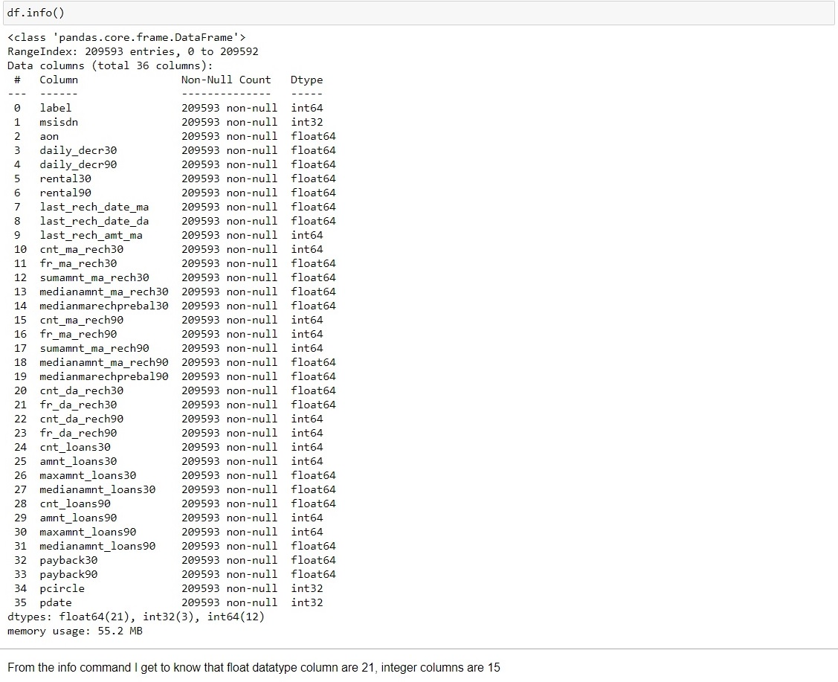
Label is an independent variable where as all of the other element are dependent variable.

Slide 5
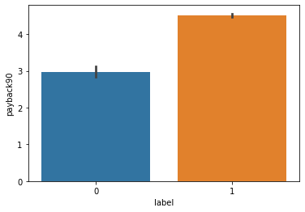
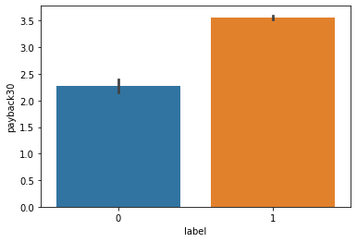
In the label value 0 represent the failure of the payment and 1 Represents the successor who had paid credit successfully.
Based on the given data following are the our initial findings:-

Slide 6
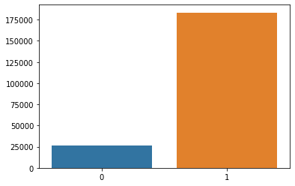
The average payback time is less for the defaulter cases as compare to other category in both of the scenarios.
From the above graphical chart we can easily understand that out of 200K subscribers on 25K did not paid the credit back.

Slide 7
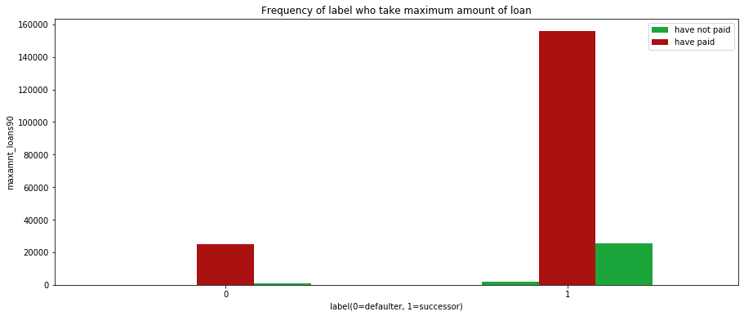
From the above graphical chart following is our finding:-
The subscriber who have not paid the credit is less the 10% of the total who have taken credit.

Slide 8
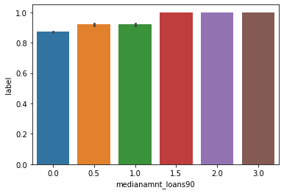
Median of amounts of loan taken by the user in last 90 days.

Slide 9
DATA PREPROCESSING
The Complete data is divided in the ration of 70:30 for train and test respectively.
I have dropped the Pcircle column since for the current processing it was not used.
There is no null value in the dataset but there are some outliers present in the dataset which has been removed with the help of predefine methods.

Slide 10
Once our data is ready categorical variables are converted into the other form, which we can apply further on algorithms.

Slide 11
Evaluation Process
Evaluation Matrices:
Accuracy - it determines how often a model predicts default and non default correctly.
Precision-it calculates whenever our models predicts it is default how often it is correct.
Recall- Recall regulate the actual default that the model is actually predict.
Precision Recall Curve - PRC will display the tradeoff between Precision and Recall threshold.
Cross Validations:
K Fold cross validations , K = 5

Slide 12
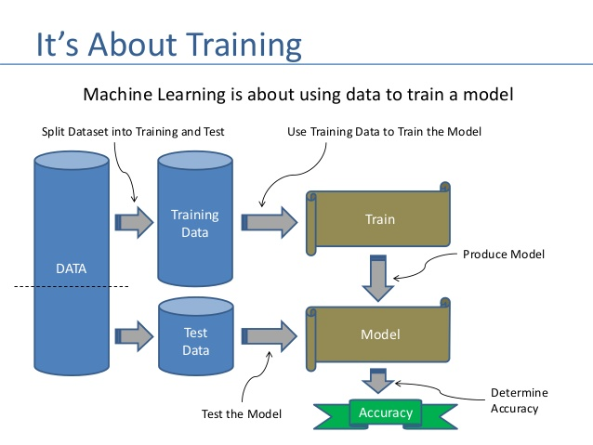

Slide 13
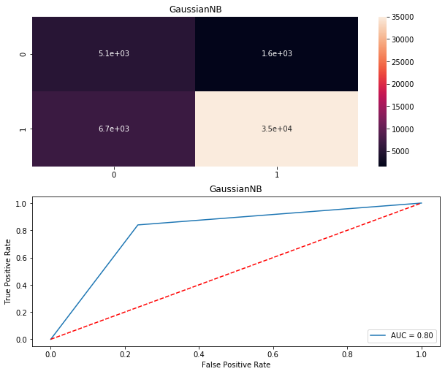
GaussianNB AUC

Slide 14
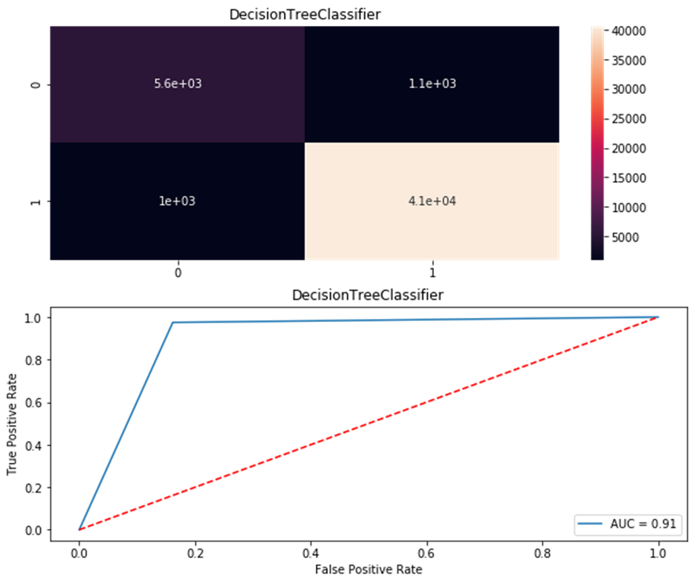
Decision Tree AUC

Slide 15
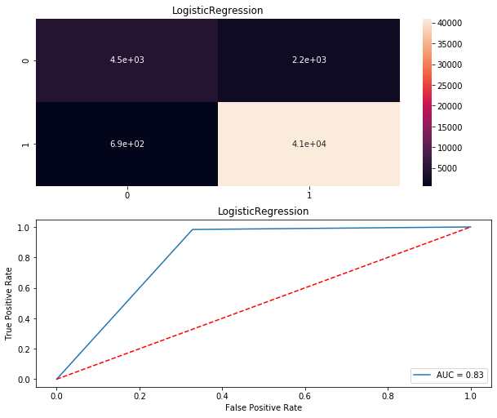
Logistic Regression AUC

Slide 16
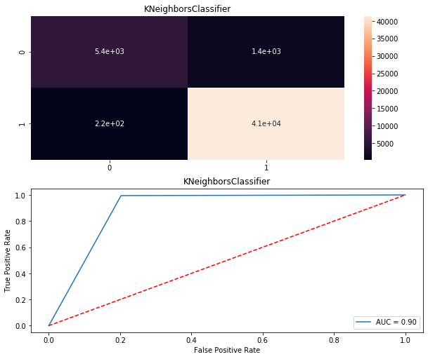
KNeighboursClassifier

Slide 17
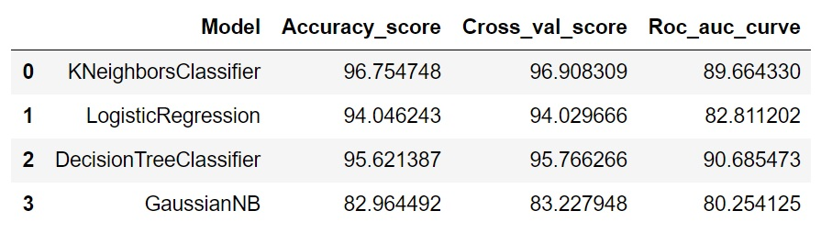
Result
From the details in the below table it is clearly understandable that we are getting best result with the help of KNeighborsClassifier so we save this model with the help of joblib Library.

Slide 18
Conclusion
I check the data first and uploaded the data in jupyter notebook and than I visualize the features ,Perform the preprocessing in the data and understand the relationship between different features.
I used both train-validation split and the cross validation to evaluate the model effectiveness to predict the target values.
At the end I applied the four predictive models in the data.
I started with KNeighboursClassifier,Logistic Regression,
Decision Tree Classifier,GaussianNB and based on the best result I saved to model KNeighboursClassifier.

